Slide 1
Electron Express A Look at Node.js, Packages and Desktop Apps
Stephen Downes
National Research Council Canada
February 28, 2019

Slide 2
Install… Node.js Node.js is an environment that runs Javascript code. Node can be used to run web server applications as well as desktop applications. That’s what this presentation is about.
https://nodejs.org/en/download/

Slide 3
Install… Git Git allows to you access and update software from code versioning libraries. We use it to get and run programs authored by other people.
https://git-scm.com/downloads

Slide 4
Install… Visual Studio Code Visual Studio Code is an Integrated Development Environment (IDE).
https://code.visualstudio.com/download

Slide 5
Core Concepts Files and Folders Like (say) Windows Explorer (pictured here)

Slide 6
Core Concepts Text Editor Like (say) Windows Notepad (pictured here)

Slide 7
Core Concepts Command Shell Like (say) Windows Command Prompt or Power Shell (pictured here). Executes typed commands (instead of clicking on icons)
https://cdn.comparitech.com/wp-content/uploads/2018/08/Comparitech-Powershell-cheatsheet.pdf

Slide 8
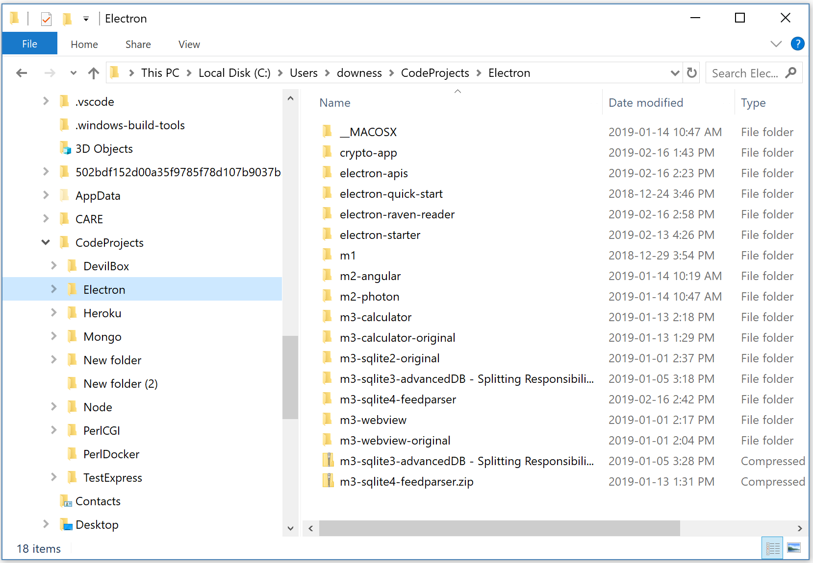
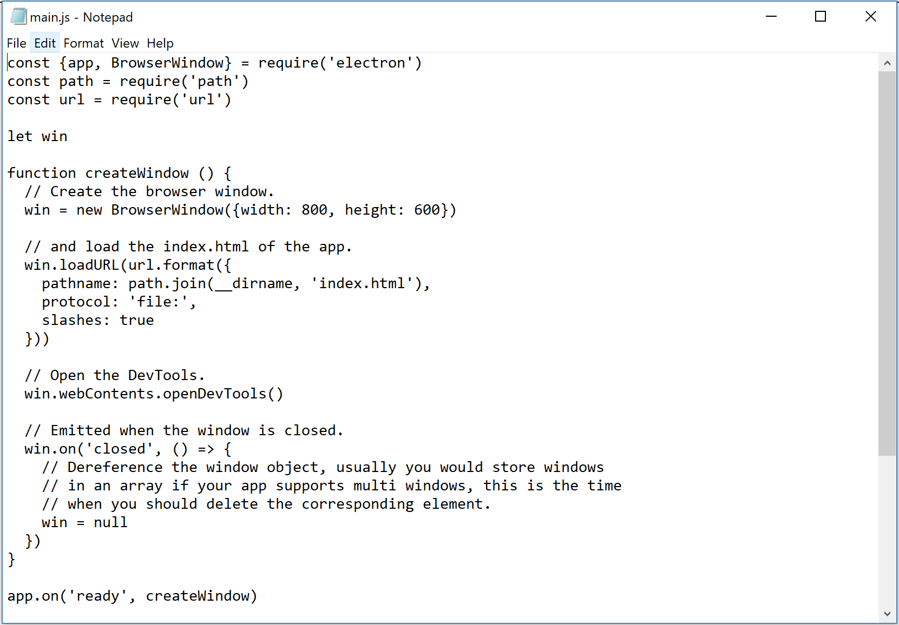
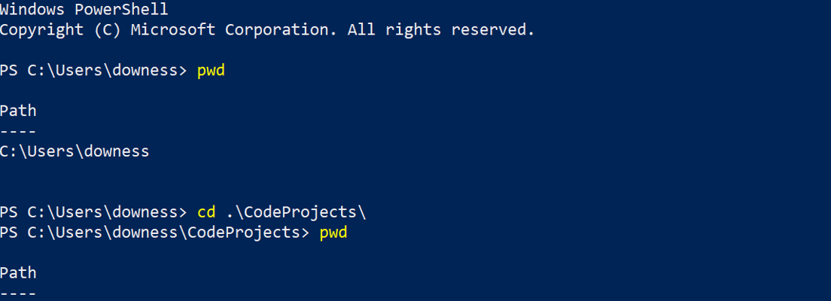
Development Environment Integrates explorer, text editor and command shell

Slide 9
Development Environment Visual Studio Code Integrates and provides options for directories and files, text editor, and command window

Slide 10
Path Test Git and Node run from the command line in the shell. Test them in the command shell If they don’t work, they have to be added to the path (probably)
C:\Users\downess\CodeProjects

Slide 11
Path Add to Path Use the Windows system settings to add Git and/or Node to the Windows path. The path tells Windows where to look for a command line program.
https://stackoverflow.com/questions/26620312/installing-git-in-path-with-github-client-for-windows

Slide 12
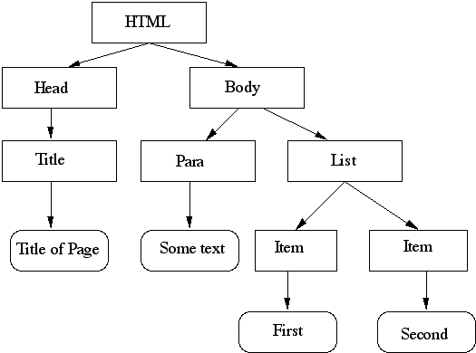
Javascript DOM Javascript uses selectors to interoperate with a web page Document Object Model (DOM) to get and manipulate web page values. There is also an analogous Browser Object Model (BOM).
document.getElementById("p1").innerHTML = "New text!";
https://www.w3schools.com/js/js_htmldom.asp

Slide 13
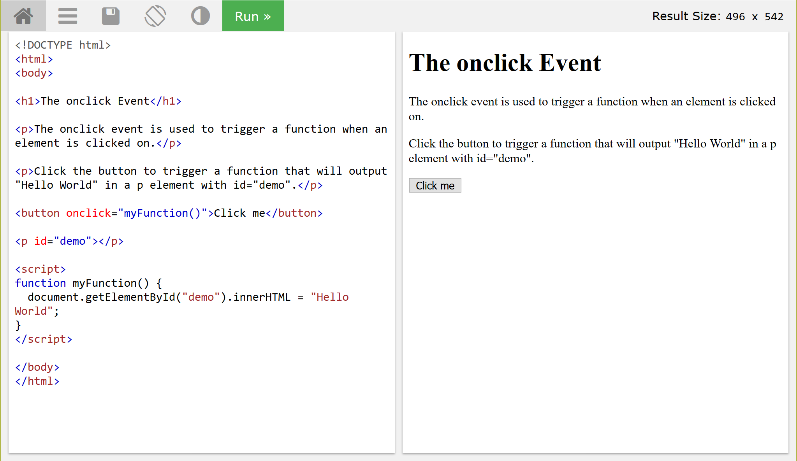
Javascript Events Javascript uses listeners to respond to events on a web page such as page loads, clicks, changes in forms, mouse hovers, etc.
https://www.w3schools.com/jsref/tryit.asp?filename=tryjsref_onclick
https://www.w3schools.com/jsref/dom_obj_event.asp

Slide 14
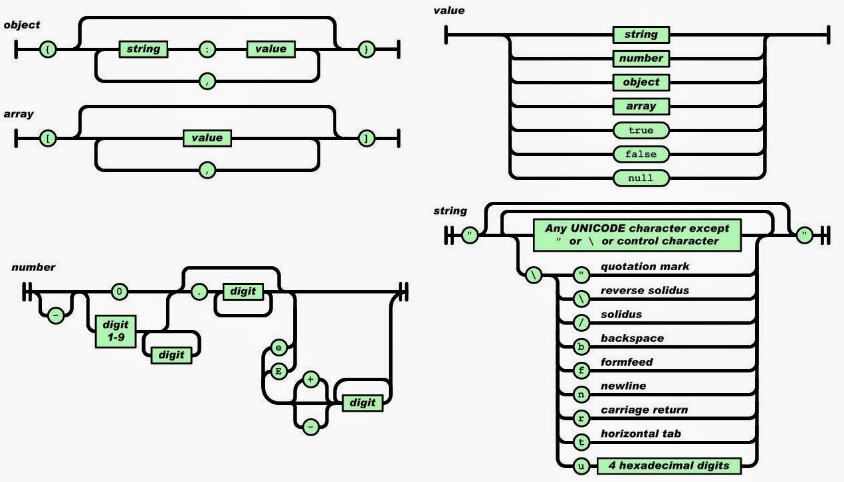
Javascript JSON In Javascript data structures are represented using text formatted as Javascript Object Notation (JSON). Because JSON is text, it can be easily edited, and sent and stored almost anywhere.
https://www.w3schools.com/js/js_json_intro.asp https://www.json.org/

Slide 15
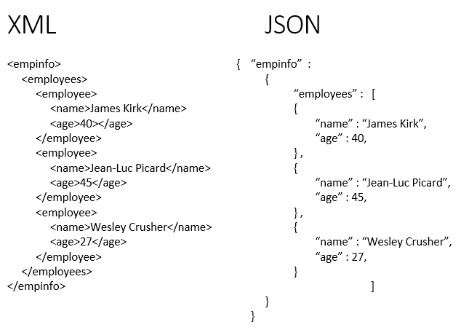
Javascript JSON JSON is a native Javascript format. You can read and write to it directly using a selector. So there is no complicated parsing of data being exchanged, as there is in XML.
https://www.w3schools.com/js/js_json_intro.asp https://www.json.org/

Slide 16
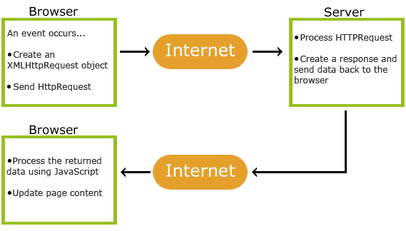
Javascript AJAX Javascript uses Asynchronous JavaScript And XML (AJAX) to read data from a web server after the page has loaded, update a web page without reloading the page, and send data to a web server - in the background.
https://www.w3schools.com/js/js_ajax_intro.asp

Slide 17
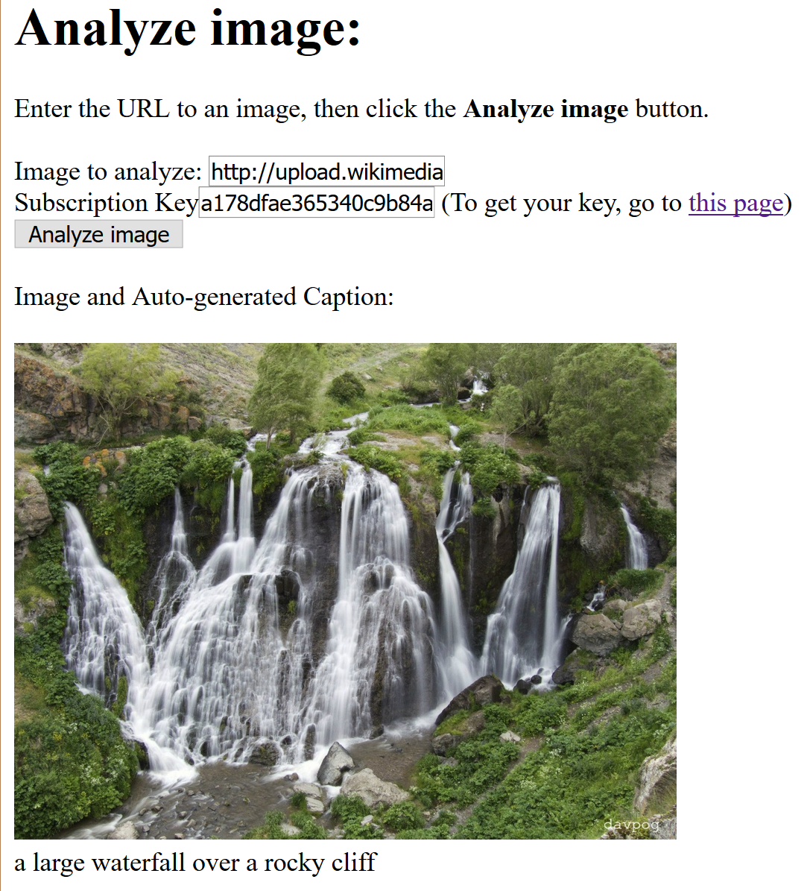
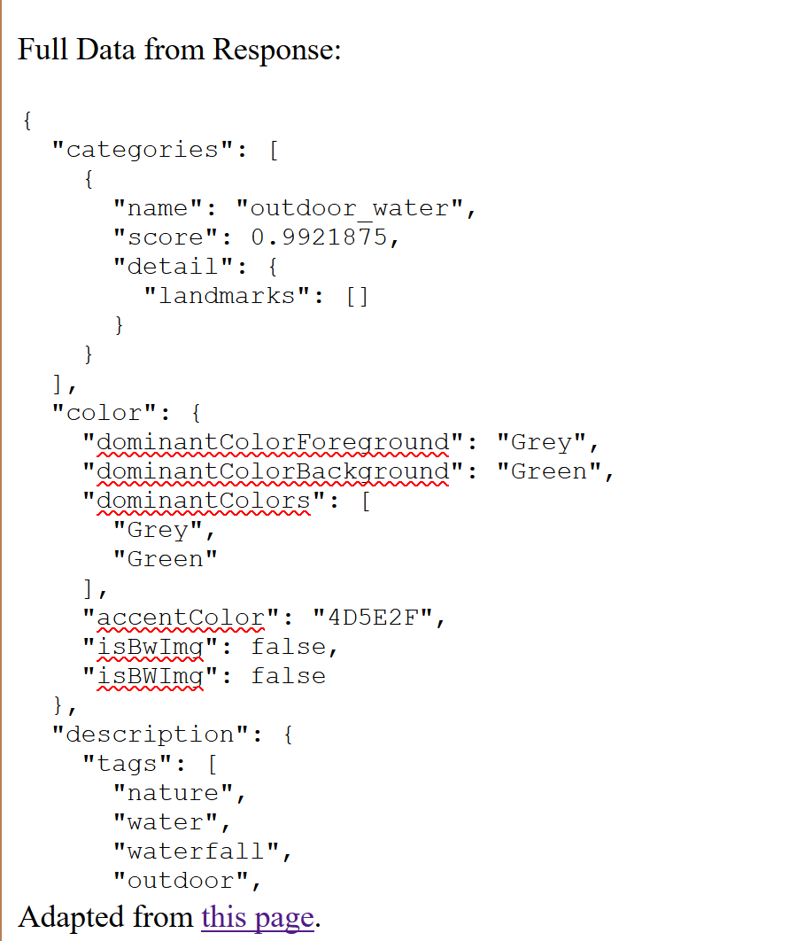
Javascript AI Services Send an API request using AJAX and API key to MS Cognitive Services (Computer Vision) to create alt text for images.
C:\Users\downess\CodeProjects\MS-API\Computer Vision
https://www.downes.ca/files/msindex.html
https://docs.microsoft.com/en-us/azure/cognitive-services/Computer-vision/quickstarts/javascript-analyze

Slide 18
Javascript jQuery jQuery is a Javascript library that simplifies Javascript (and especially selectors and listeners). It’s often included in web pages as a remote script (ie., <script src=“jquery.js”>)
https://www.w3schools.com/jquery/default.asp

Slide 19
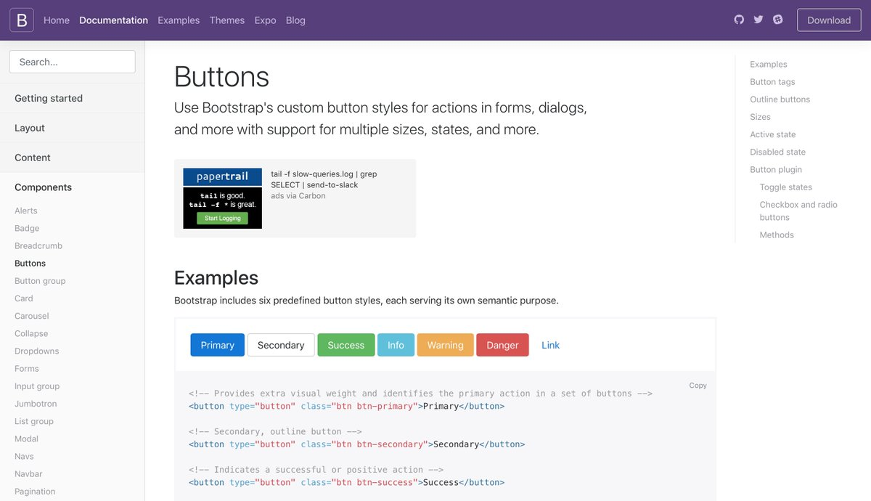
Javascript Bootstrap Bootstrap is a Javascript library built on top of jQuery that automates a lot of web page styling and interface elements. It makes it a lot easier to support mobile devices and accessibility standards (aka ARIA).
https://getbootstrap.com/

Slide 20
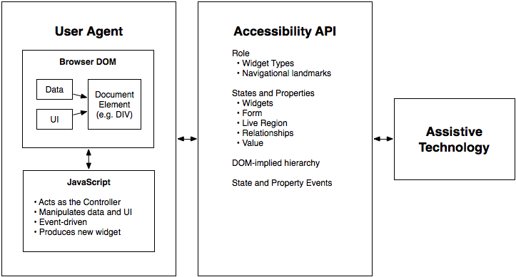
Javascript ARIA The Accessible Rich Internet Applications (ARIA) standard provides an interface between Javascript DOM elements and assistive technologies.
https://www.w3.org/TR/wai-aria/
https://developers.google.com/web/fundamentals/accessibility/semantics-aria/

Slide 21
Javascript Frameworks These are frontend libraries that manage interactions with backend services.
Angular: https://angular.io/
React: https://reactjs.org/
Vue: https://vuejs.org/
https://medium.com/zerotomastery/tech-trends-showdown-react-vs-angular-vs-vue-61ffaf1d8706
https://www.codeinwp.com/blog/angular-vs-vue-vs-react/

Slide 22
Node.js Server Node.js is a way of running Javascript on the server. In many ways, it is a web server. Node.js is run from the command line, and you can access it with a web browser.
Script in text file: app.js (edit in the text editor)
Run script (use the command line)
View in browser (http://localhost:8080)
var http = require('http'); http.createServer(function (req, res) { res.writeHead(200, {'Content-Type': 'text/plain'}); res.end('Hello World!'); }).listen(8080);
C:\Users\downess\CodeProjects\Node\app
http://localhost:8080
https://www.w3schools.com/nodejs/default.asp

Slide 23
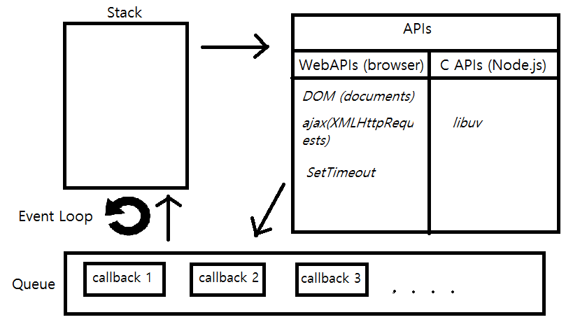
Node.js Event Loop Node.js runs commands one-by-one in the stack, but puts API calls to one side instead of waiting for them. When the stack is completed, it executes the first response in the queue sent back from the APIs.
http://vucuong12.github.io/2015/11/02/Javascript%20Event%20Loop%20with%20Node.js%20for%20Beginners/

Slide 24
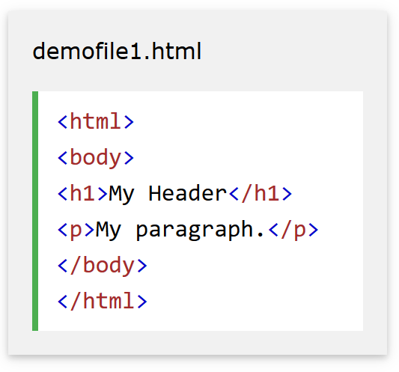
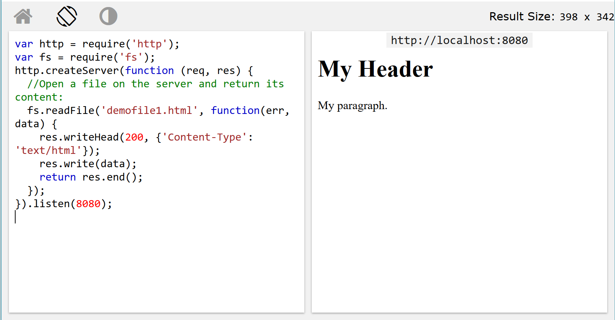
Node.js Files Node.js can read and write to files on the local machine. Thus it can read files and make them available to a web browser.
C:\Users\downess\CodeProjects\Node\w3schools
http://localhost:8080
https://www.w3schools.com/js/js_json_intro.asp https://www.json.org/

Slide 25
Node.js Modules Other built-in Node.js modules include URL (for web requests), Events (for listeners), Upload Files, and Email.
var nodemailer = require('nodemailer'); var transporter = nodemailer.createTransport({ service: 'gmail', auth: { user: 'youremail@gmail.com', pass: 'yourpassword' } }); var mailOptions = { from: 'youremail@gmail.com', to: 'myfriend@yahoo.com', subject: 'Sending Email using Node.js', text: 'That was easy!' }; transporter.sendMail(mailOptions, function(error, info){ if (error) { console.log(error); } else { console.log('Email sent: ' + info.response); } });
C:\Users\downess\CodeProjects\Node\w3schools
http://localhost:8080
https://www.w3schools.com/nodejs/nodejs_email.asp

Slide 26
Node.js NPM NPM is the Node Package Manager. It comes with Node. It provides a way to obtain and install Node packages written by other developers. NPM runs from the command line. An alternative to NPM is Facebook’s YARN.
https://www.npmjs.com/ https://yarnpkg.com/en/

Slide 27
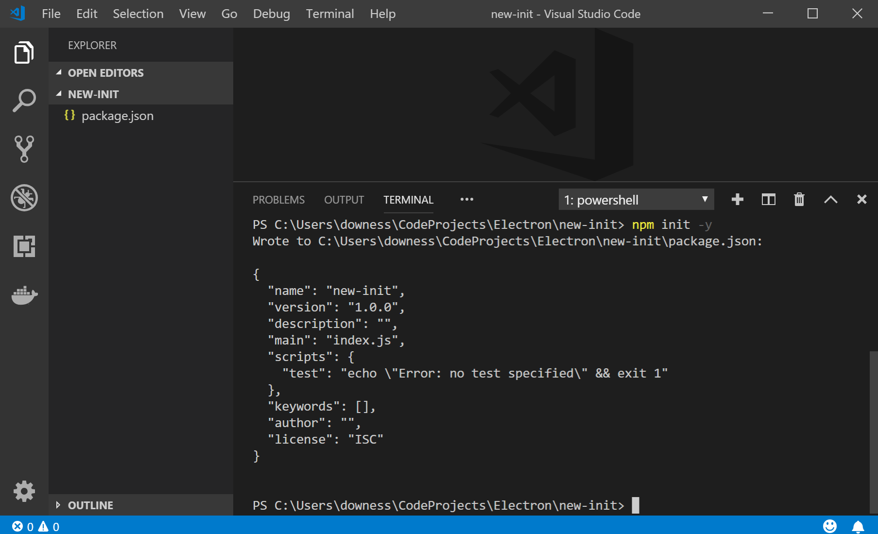
NPM Init NPM relies on a file called package.json to tell it what to do. Create a new package.json file using the command npm init. (You could also use a text editor but this is easier)
https://docs.npmjs.com/creating-a-package-json-file

Slide 28
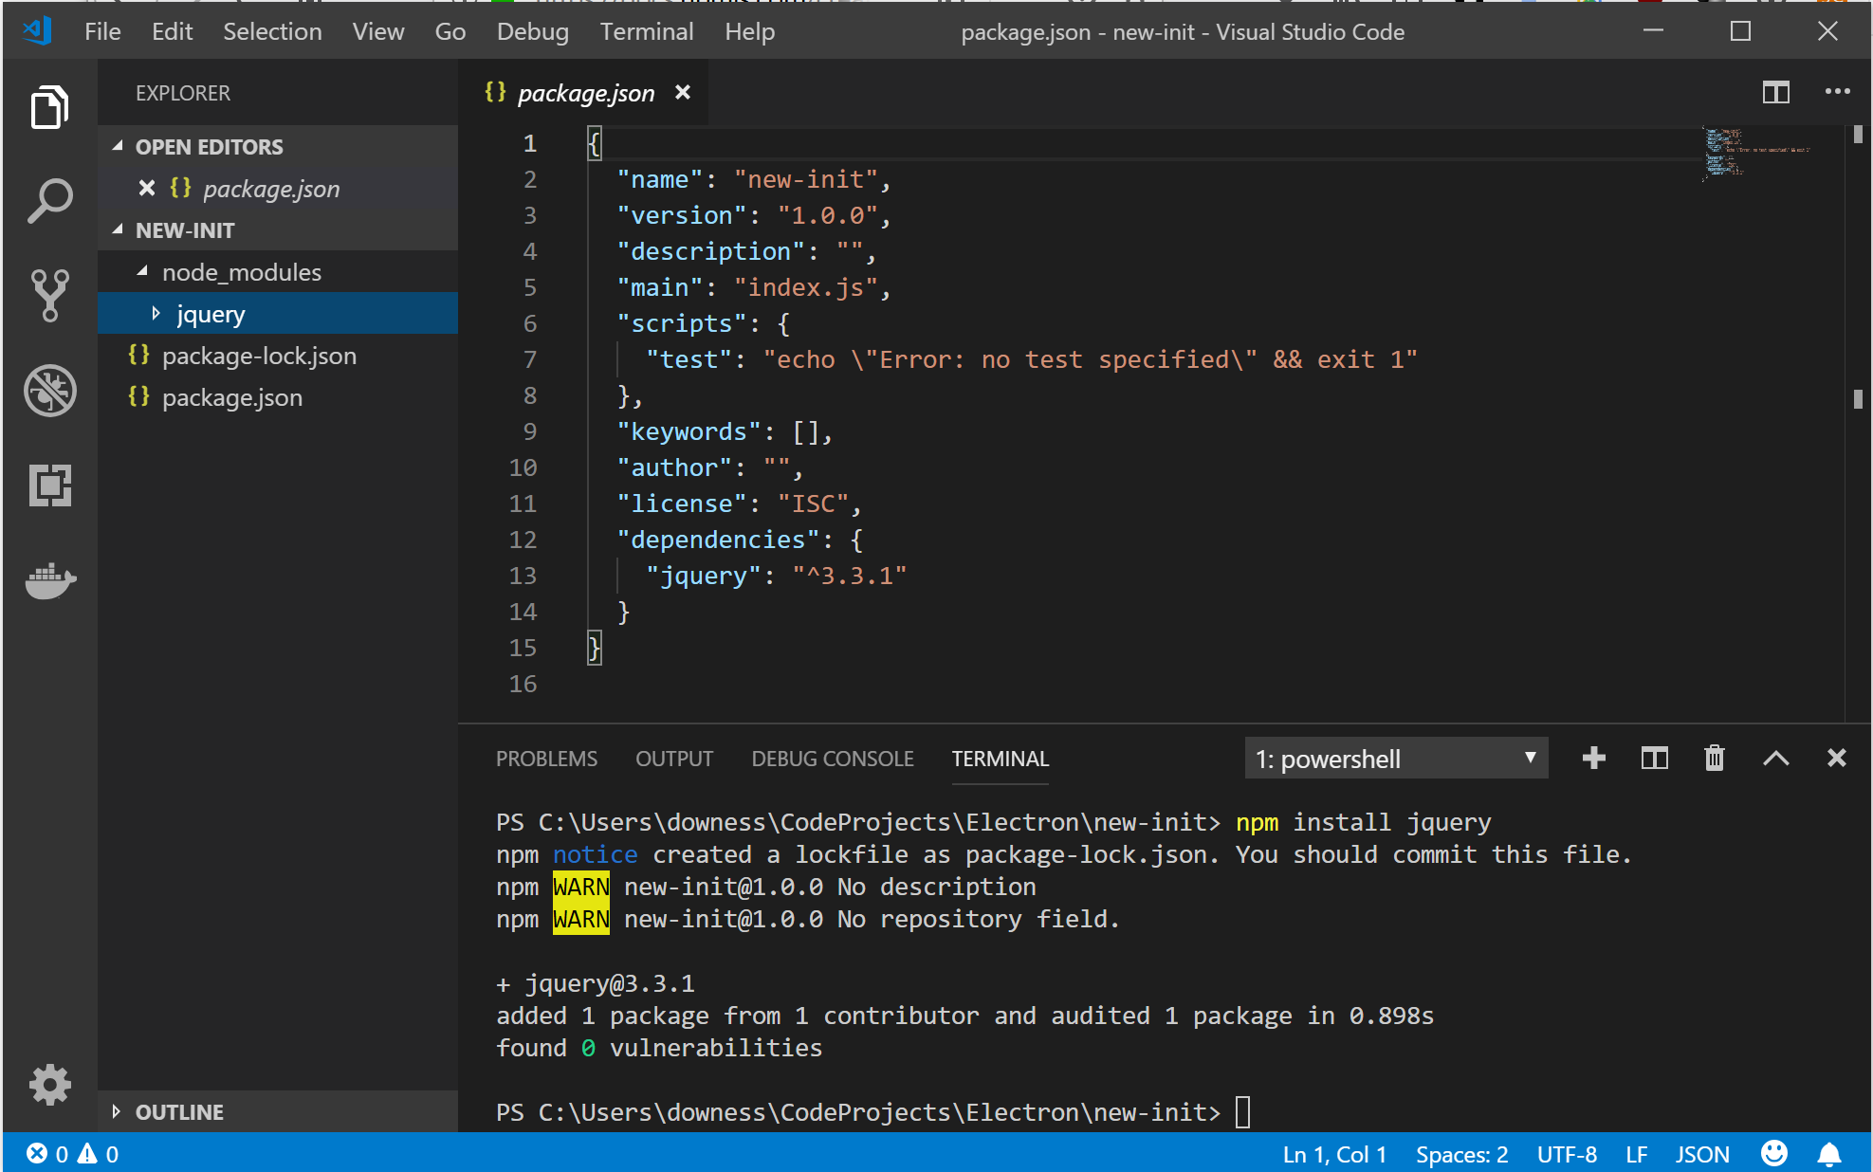
NPM Install Install a new Node package using the npm install command. For example, to install jQuery: npm install jQuery This downloads files, and also adds a line in package.json, as shown.
https://docs.npmjs.com/cli/install

Slide 29
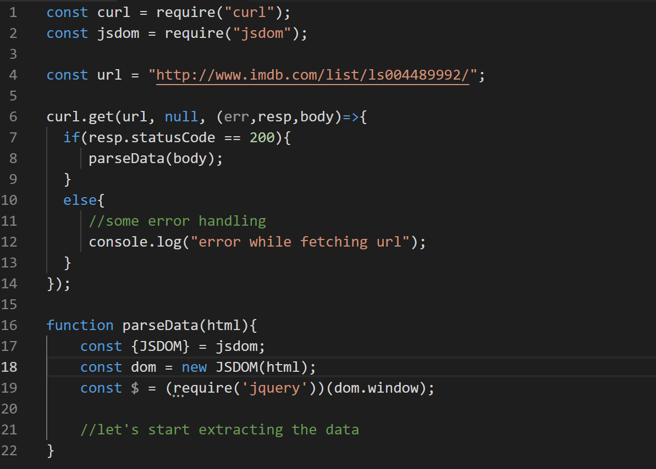
NPM Const Use a package by declaring a ‘const’ in a script. This makes objects and functions available to the script. Node won’t run the if-then in curl.get() until it gets a response from the web server. The example uses jQuery to scrape the IMDB website for James Bond films.
https://medium.com/@asimmittal/using-jquery-nodejs-to-scrape-the-web-9bb5d439413b
Updated script for example: https://gist.github.com/Downes/630c639ca77e01a21782ce2e22b20ad8

Slide 30
NPM Windows Save some heartache and run this. It installs Windows dev tools globally (-g) including Visual Studio Build and Python 2.7 (needed for some Node.js modules).
npm install --global --production windows-build-tools
https://github.com/tensorflow/tfjs/issues/741

Slide 31
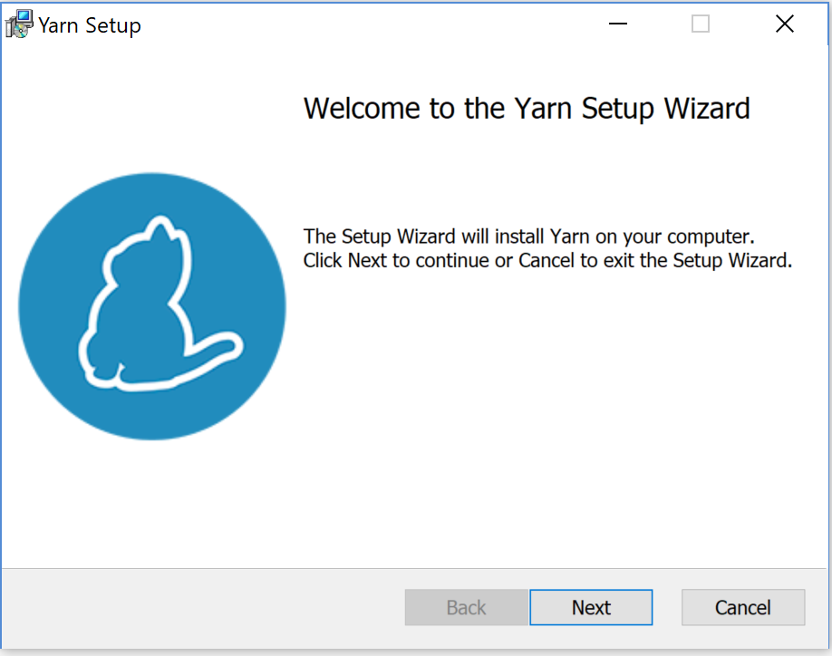
Yarn Install Yarn is an alternative to NPM. - builds package.json
https://yarnpkg.com/

Slide 32
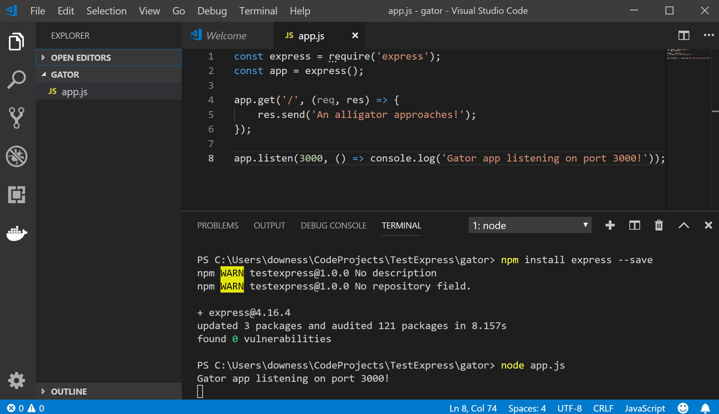
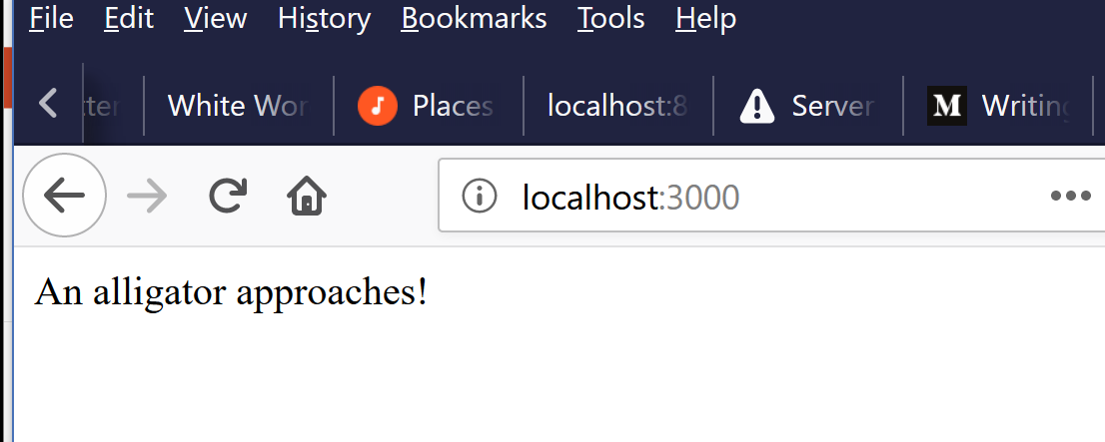
Express Install The Express Node framework is a set of features for web and mobile applications. It is installed using npm. It is launched and used like any other Node module using a pair of const declarations.
https://expressjs.com/
Other frameworks: Koa, Hapi
https://www.airpair.com/node.js/posts/nodejs-framework-comparison-express-koa-hapi

Slide 33
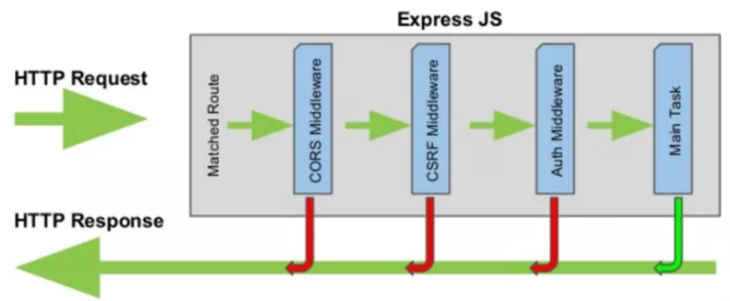
Express Middleware Express receives requests and returns a response. Middleware is used to process the request before sending a response. Eg. Is the user authorized to receive a response.
CORS – Cross Origin Resource Sharing https://expressjs.com/en/resources/middleware/cors.html
CSRF – Cross Site Request Forgery
Auth – Passwords / OAuth
https://blog.codeanalogies.com/2017/11/03/understanding-the-basics-of-express-js/

Slide 34
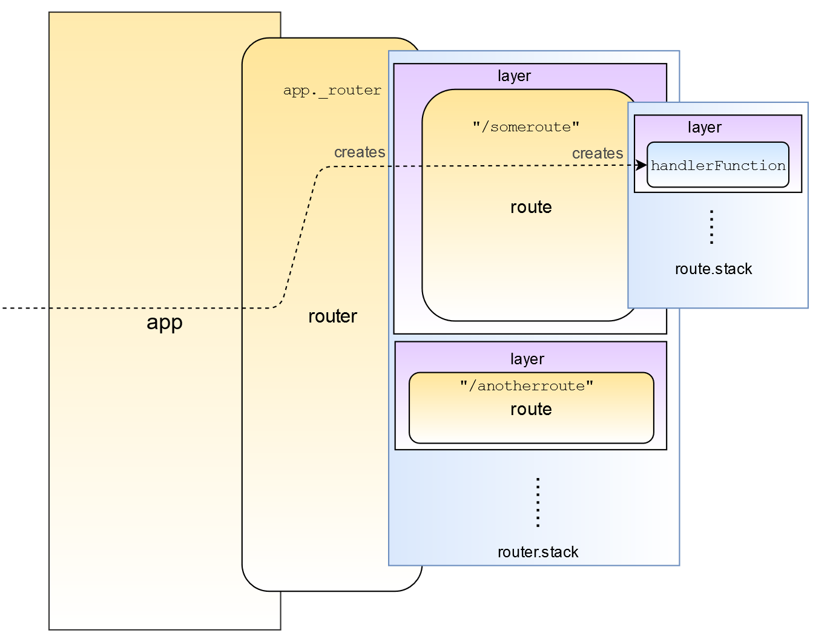
Express Routes Express requests are handled by various routes corresponding to a request type (GET, POST, PUT, etc) and an optional path.
https://developer.mozilla.org/en-US/docs/Learn/Server-side/Express_Nodejs/routes

Slide 35
Express Response Express responses are handled by the response object (res). For example, res.send() or res.json() The response can also be formatted by template engines, eg. Pug
The response object
Using a template engine
https://expressjs.com/en/guide/using-template-engines.html
https://github.com/expressjs/express/wiki#template-engines
https://fullstack-developer.academy/res-json-vs-res-send-vs-res-end-in-express/

Slide 36
Express Generator This is a single-command installer for a full Express application. To run: $ npm start Then browse to: localhost:3000
C:\Users\downess\CodeProjects\ExpressProjects\Generate
http://localhost:3000
https://expressjs.com/en/starter/generator.html

Slide 37
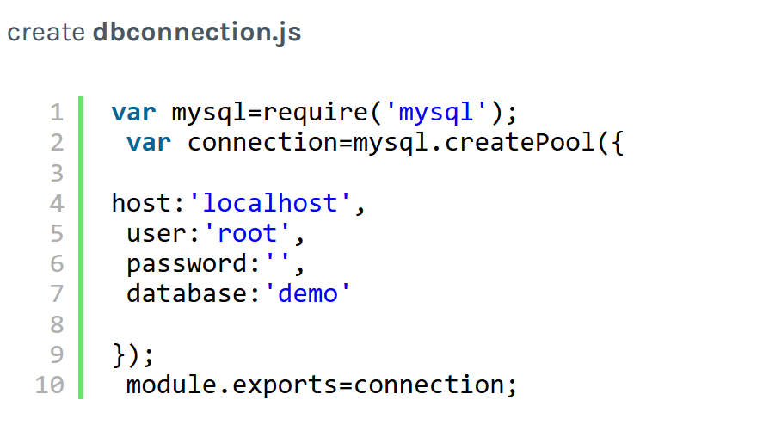
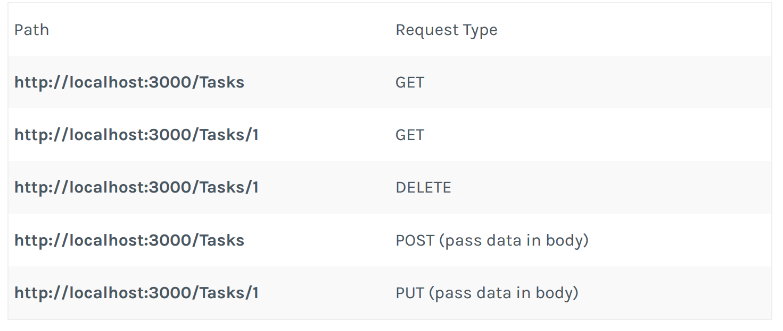
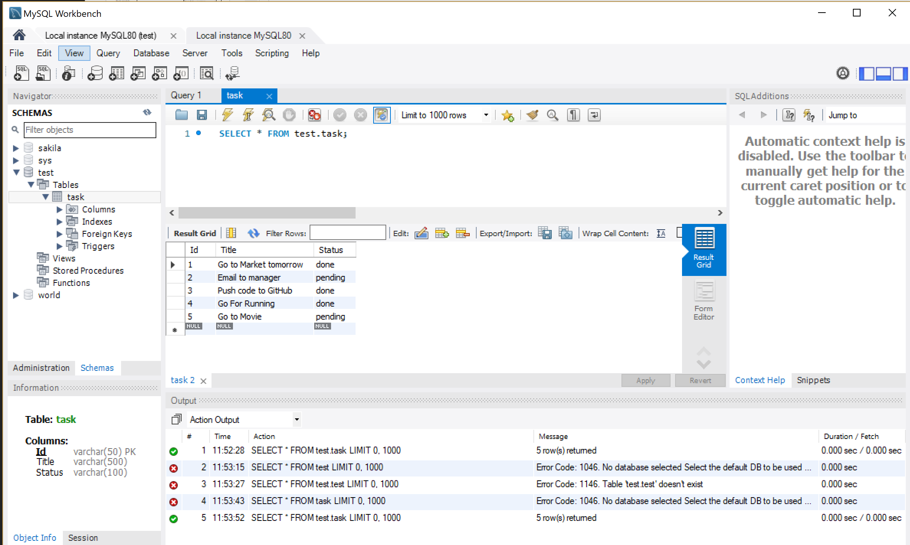
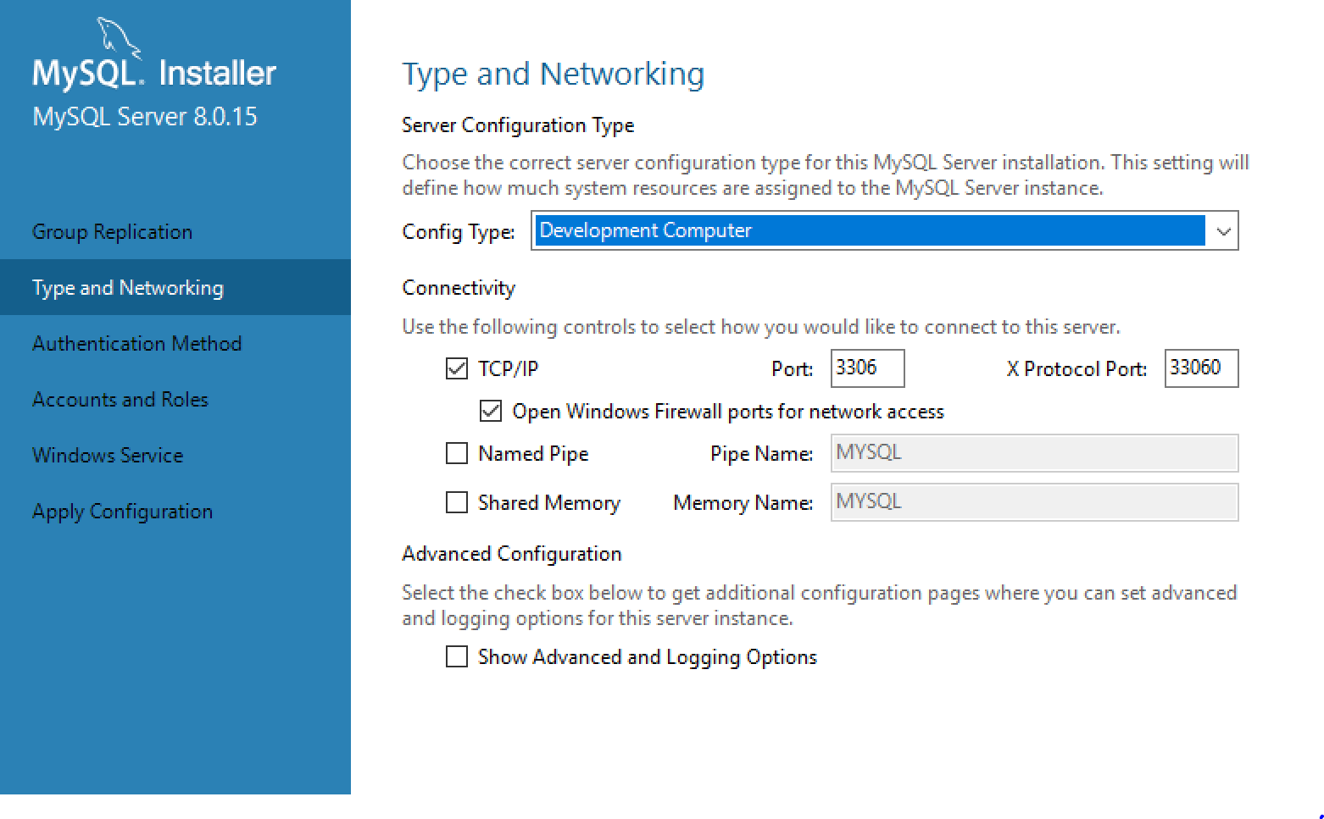
Express REST/MySQL DB Connection uses a MySQL module (and installed DB) and Express routes for Create, Read, Update and Delete (CRUD) operations.
C:\Users\downess\CodeProjects\ExpressProjects\MySQLAPI
http://localhost:3000/tasks
https://jinalshahblog.wordpress.com/2016/10/06/rest-api-using-node-js-and-mysql/

Slide 38
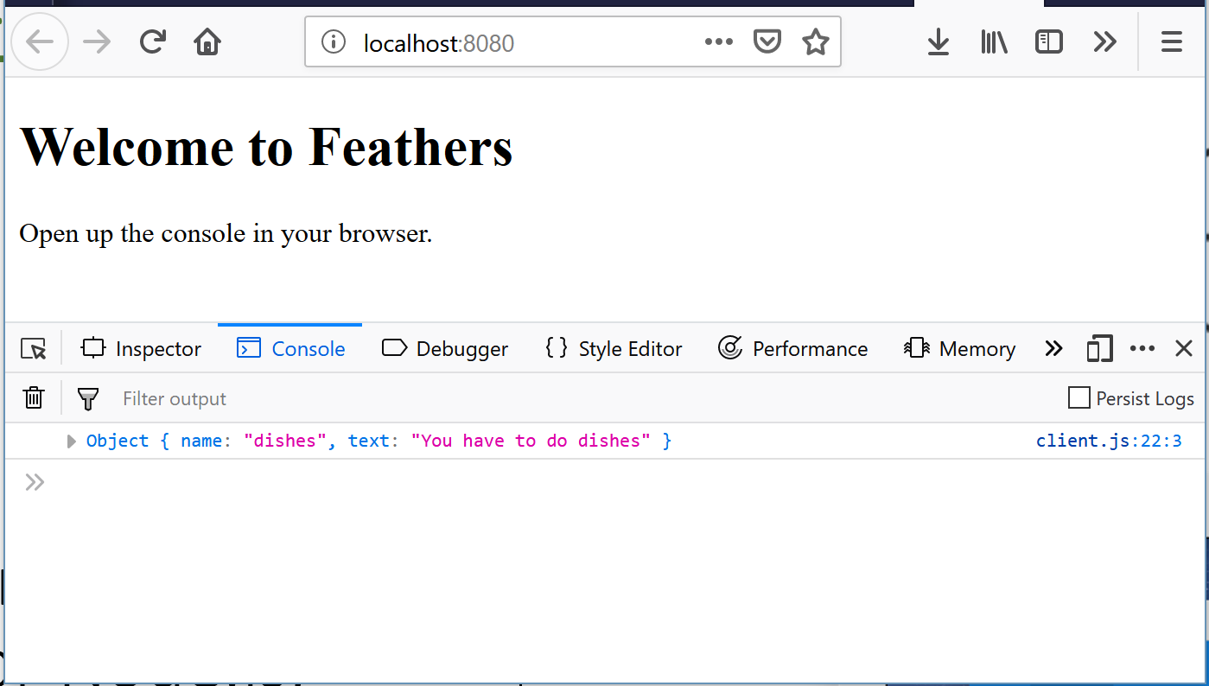
Feathers Express A REST and real-time API layer for Node.js, React Native and the browser that can be built on Express. This example uses http
C:\Users\downess\CodeProjects\ExpressProjects\Feathers
http://localhost:8080
https://feathersjs.com/ https://docs.feathersjs.com/api/express

Slide 39
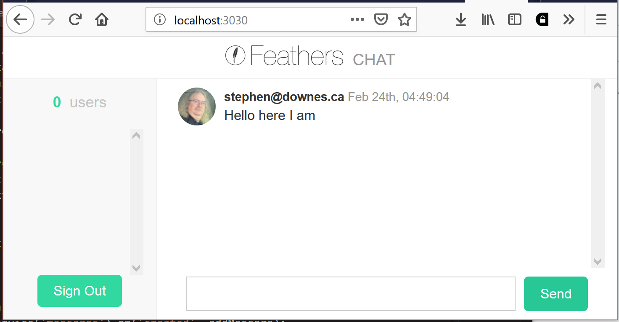
Feathers Chat This chat demonstrates the use of Feathers to create an app, services and hooks. The front-end is a longish Javascript (but could be a framework)
$ npm install @feathersjs/cli –g
$ mkdir feathers-app
$ cd feathers-app
$ feathers generate app (REST) (Postman: https://app.getpostman.com/ )
$ feathers generate service (NeDB) (https://github.com/louischatriot/nedb )
$ feathers generate authentication (JWT ) (https://auth0.com/docs/jwt )
$ feathers generate hook (x3)
C:\Users\downess\CodeProjects\ExpressProjects\Chat
http://localhost:3030/
https://docs.feathersjs.com/guides/chat/creating.html

Slide 40
Electron Processes Electron is based on a combination of two processes – the main Node.js application, and a Chromium engine as a display renderer. They communicate through Inter-Process Communication (IPC).
https://www.slideshare.net/nirnoy9/bringing-javascript-to-the-desktop-with-electron
https://electronjs.org/

Slide 41
Electron Packaging The Electron application is converted from a Node.js app to a free-standing Mac, Windows or Linux app using an electron-packager.
https://www.slideshare.net/nirnoy9/bringing-javascript-to-the-desktop-with-electron
https://electronjs.org/

Slide 42
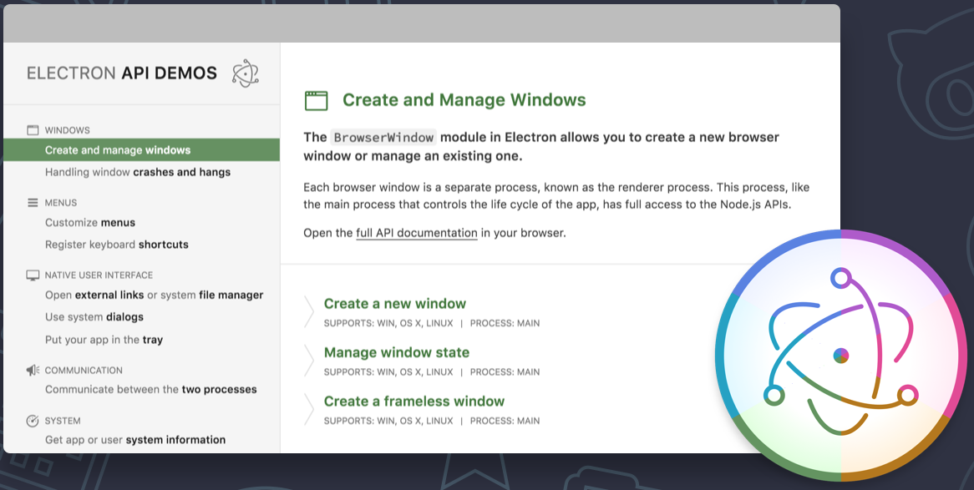
Electron APIs As an application (as opposed to a website) Electron has access to computer files and processes. The Electron API Demo shows these at work.
$ git clone https://github.com/electron/electron-api-demos
$ cd electron-api-demos
$ npm install
$ npm start
C:\Users\downess\CodeProjects\Electron\electron-apis\electron-api-demos
https://github.com/electron/electron-api-demos

Slide 43
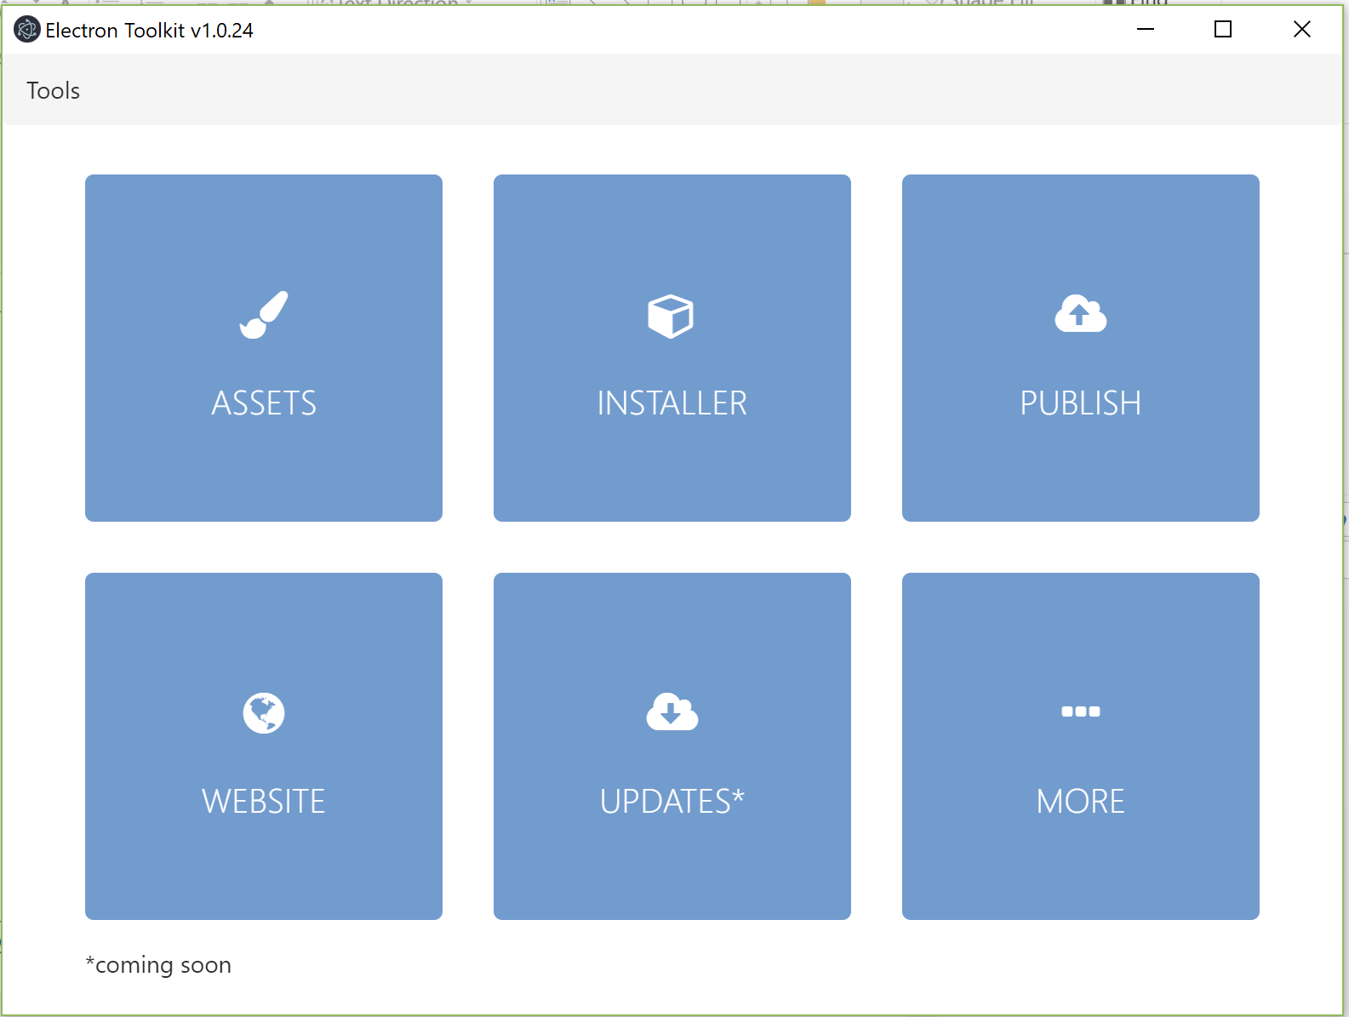
Electron Toolkit The Electron Toolkit automates a number of the tasks involved in building Electron applications, including asset management, website, and publishing to GitHub.
C:\Users\downess\CodeProjects\ElectronProjects\Toolkit
https://www.npmjs.com/package/electron-toolkit

Slide 44
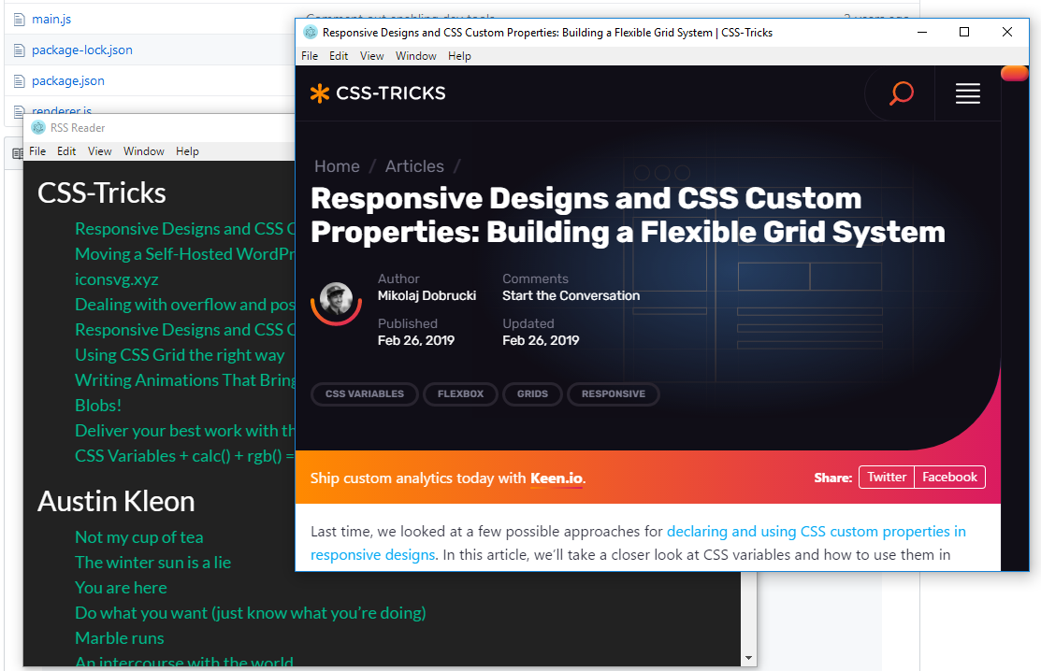
Electron RSS Reader This demo harvests some predefined RSS feeds and allows you to read the articles. Note that because Chromium is a browser there’s no problem loading external sites.
$ git clone https://github.com/timothyjellison/rss-reader-electron
$ cd rss-reader-electron
$ npm install
$ npm start
C:\Users\downess\CodeProjects\Electron\rss-reader-electron
https://github.com/timothyjellison/rss-reader-electron

Slide 45
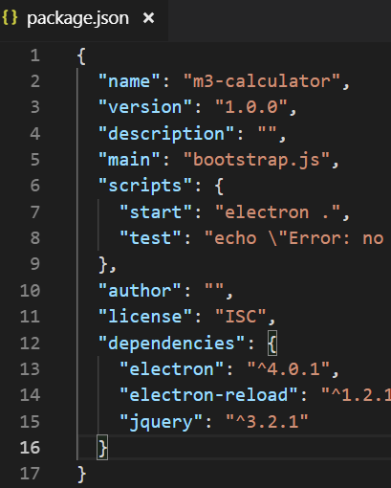
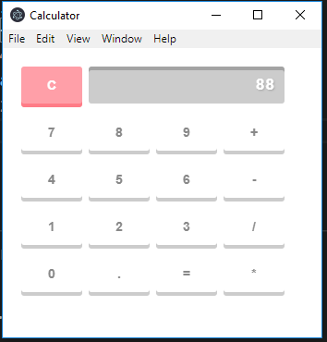
Electron jQuery This simple demo shows Electron using jQuery for formatting.
C:\Users\downess\CodeProjects\Electron\m3-calculator-original
https://halfanhour.blogspot.com/2019/01/learning-electron-part-2.html

Slide 46
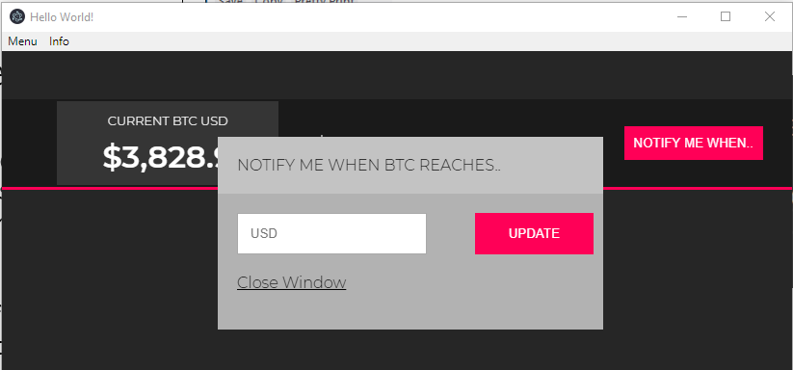
Electron Web APIs This demo accesses an external web service (in JSON, top) and displays a notification when it exceeds a set price. Good course from Coursetro
C:\Users\downess\CodeProjects\Electron\crypto-app
https://coursetro.com/courses/22/Creating-Desktop-Apps-with-Electron-Tutorial

Slide 47
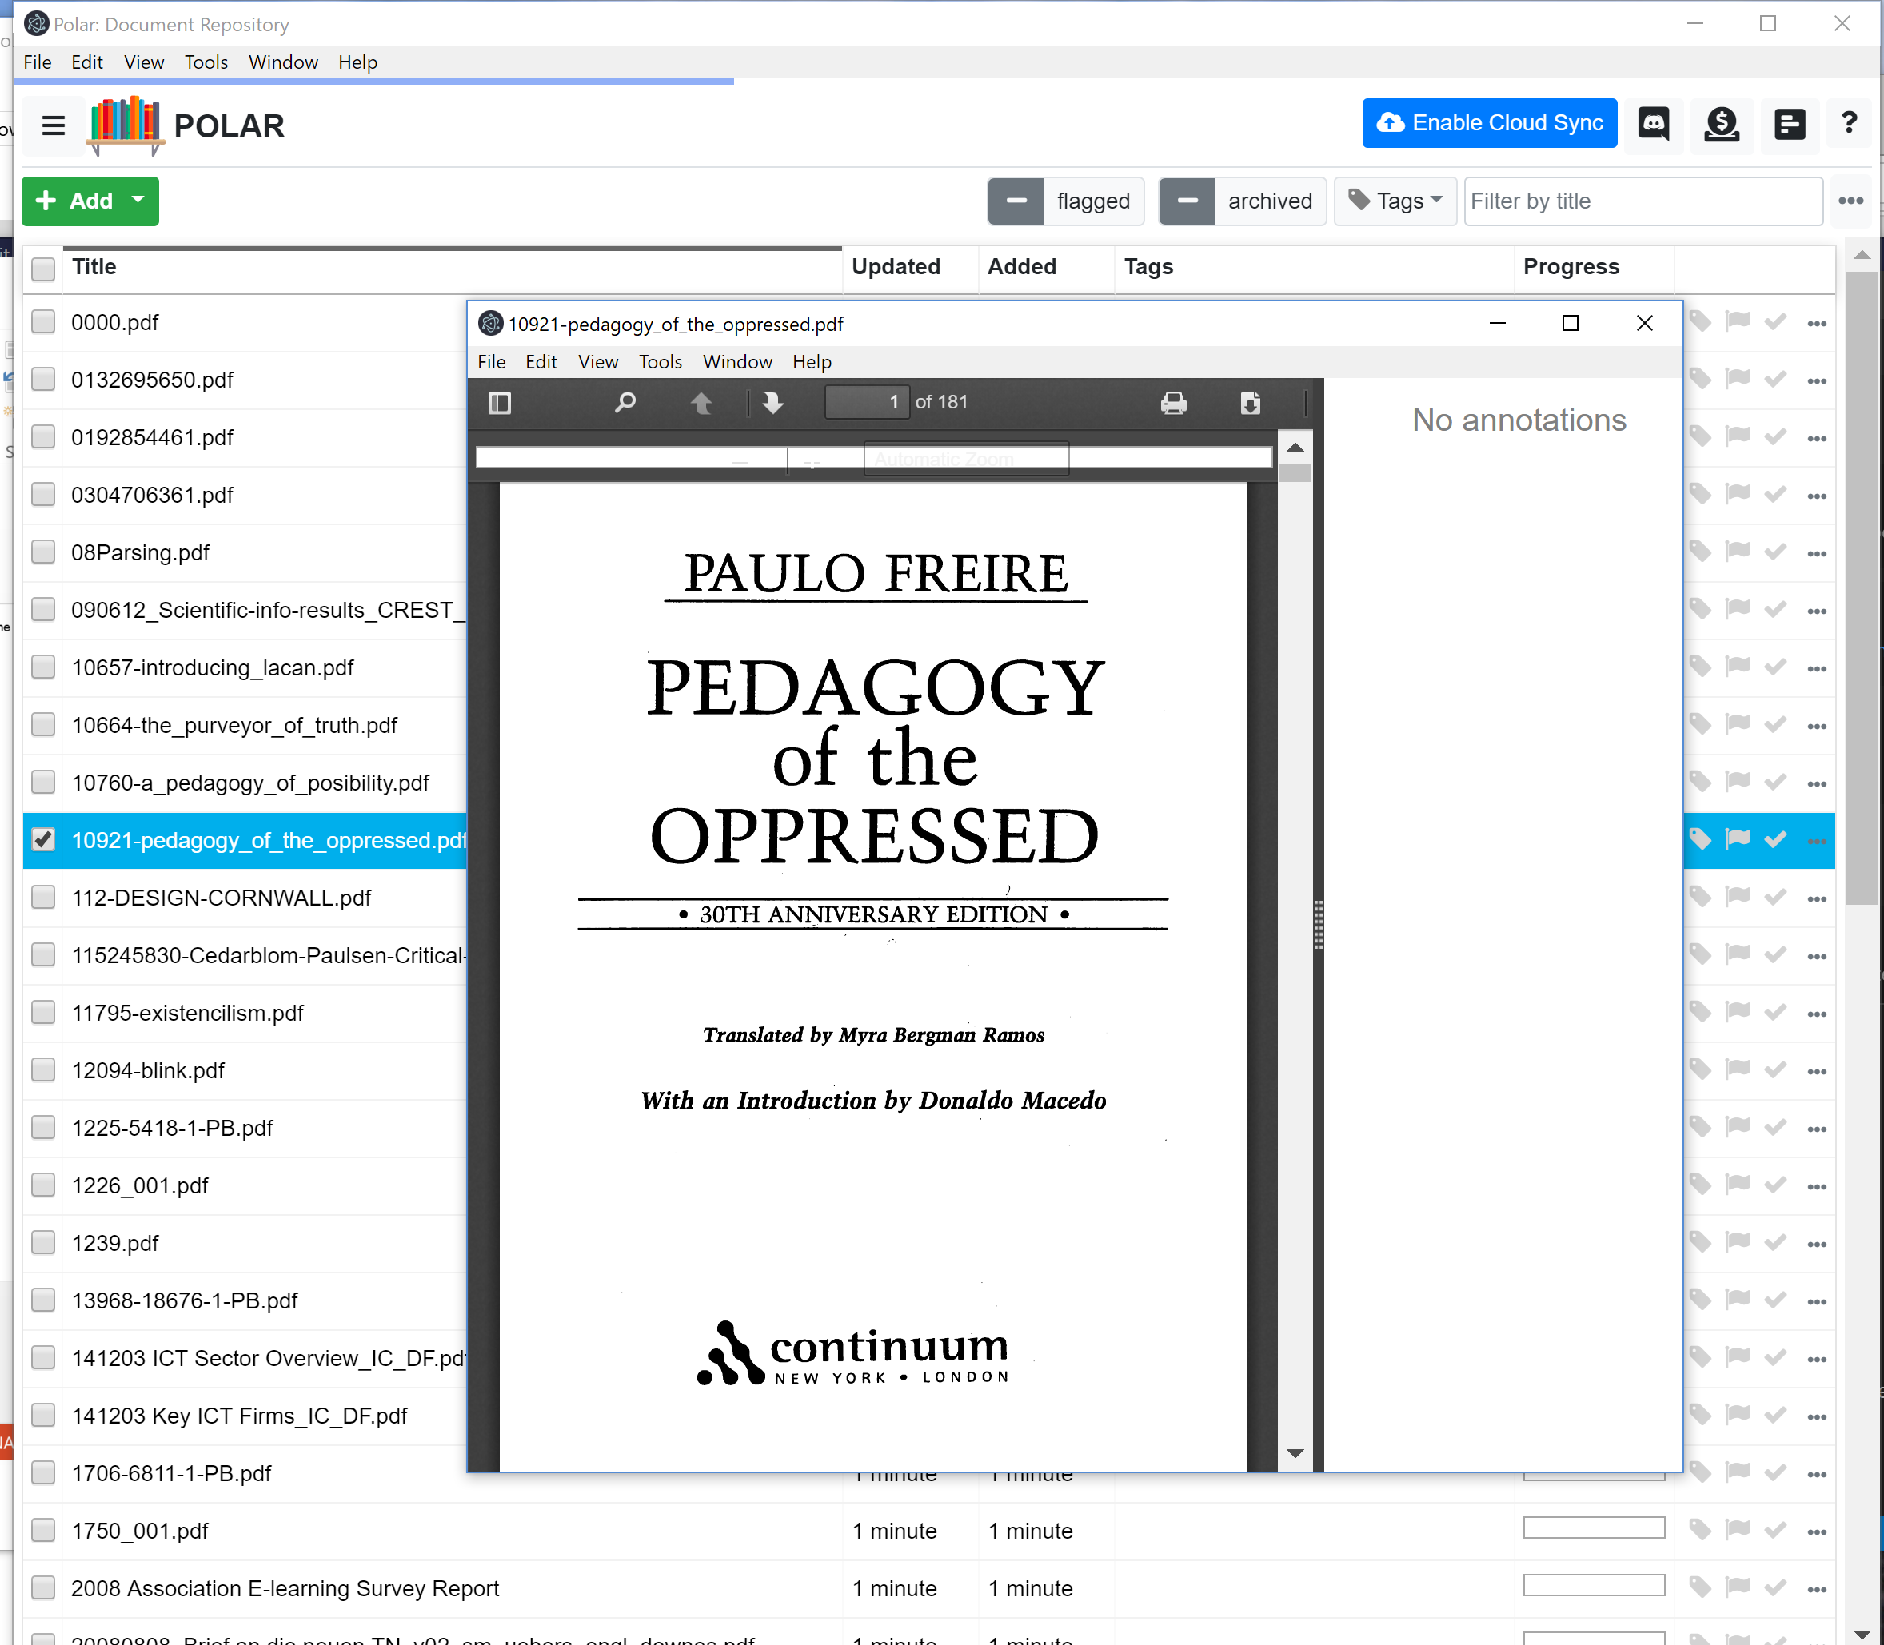
Electron Bookshelf Access and view PDF and other documents from a repository. Also has cloud sync, chat, annotations. Frontend uses a Vue framework.
C:\Users\downess\CodeProjects\ElectronProjects\polar-bookshelf
https://github.com/burtonator/polar-bookshelf

Slide 48
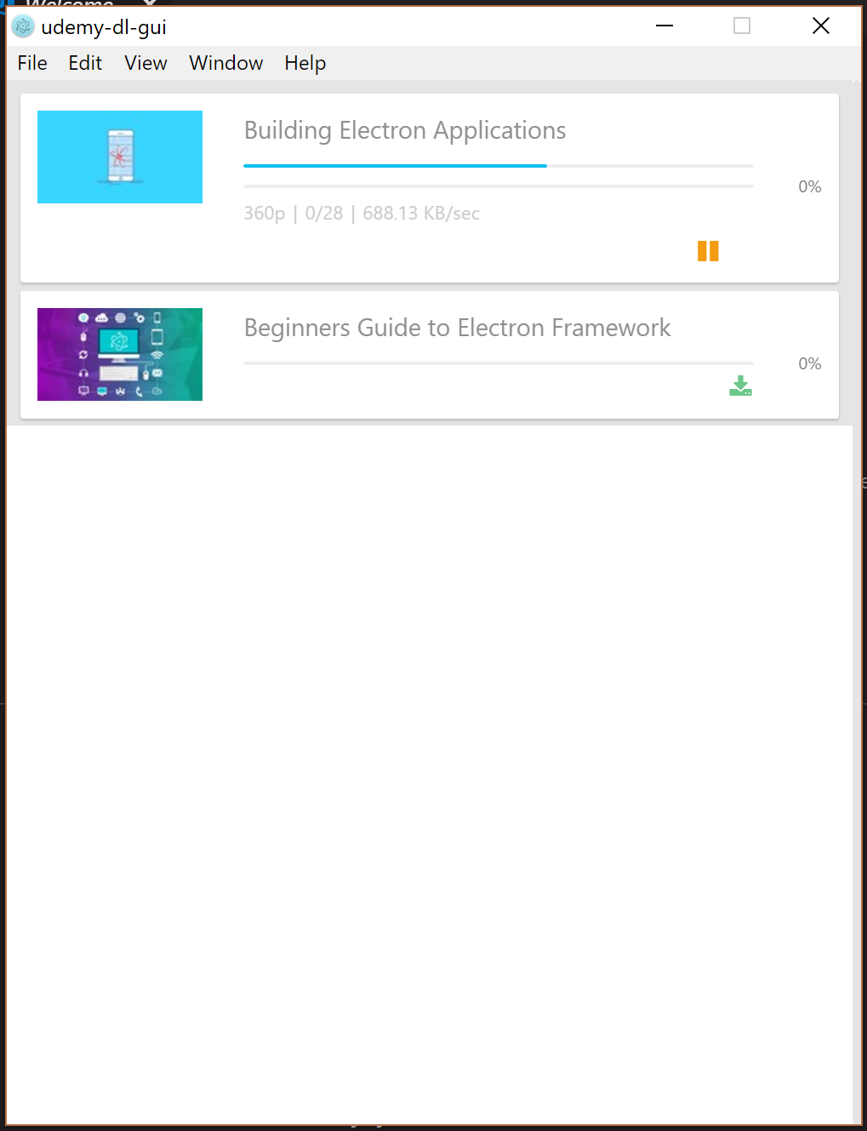
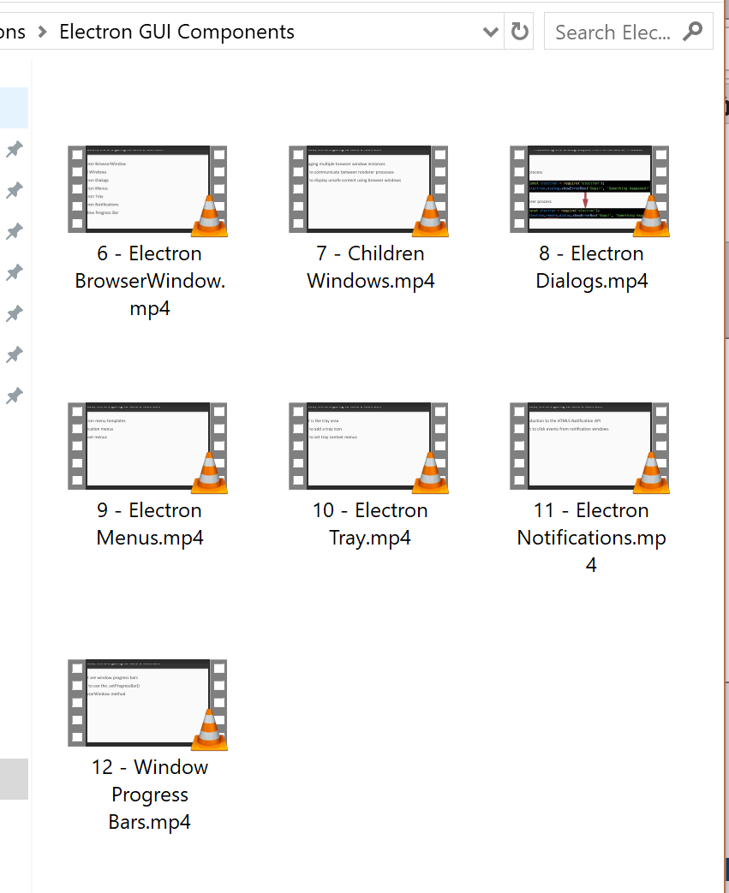
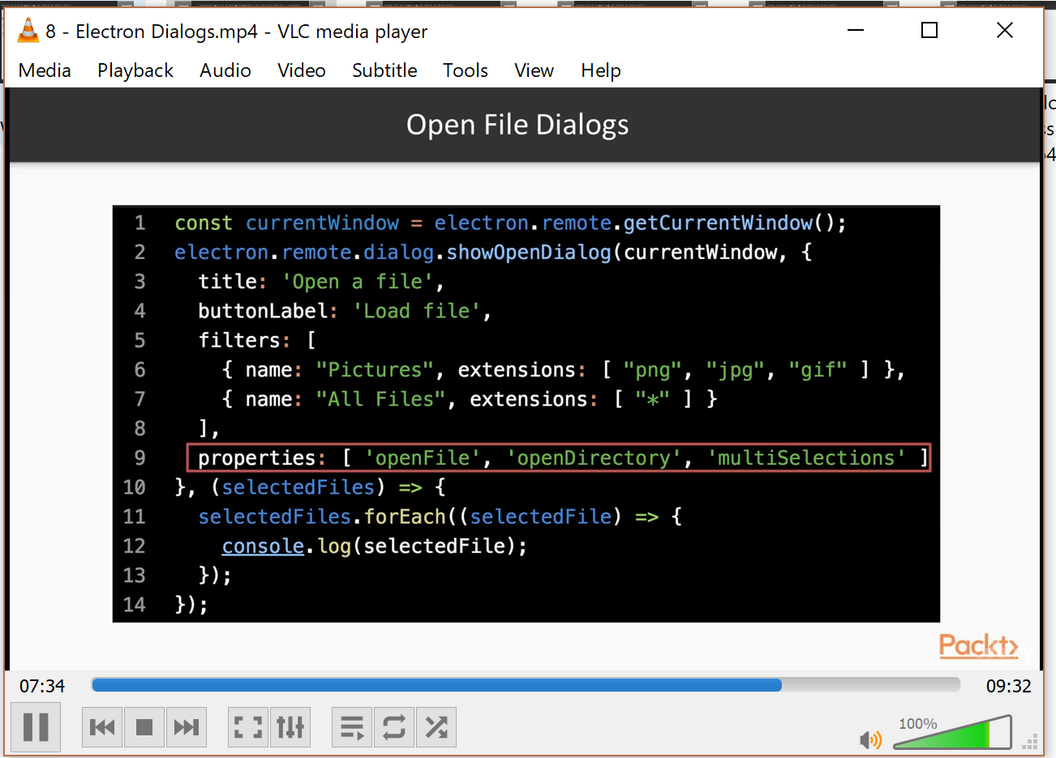
Electron Udemy DL Downloads Udemy courses for offline viewing on one’s own computer. Uses Udemy login credentials to access purchased courses.
C:\Users\downess\CodeProjects\ElectronProjects\udemy-dl-gui
https://github.com/riazXrazor/udemy-dl-gui

Slide 49
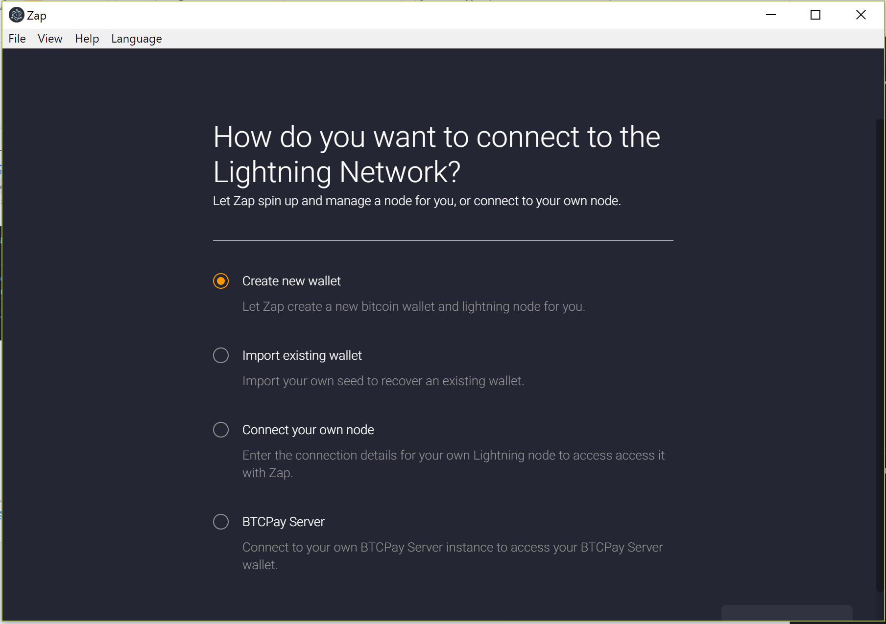
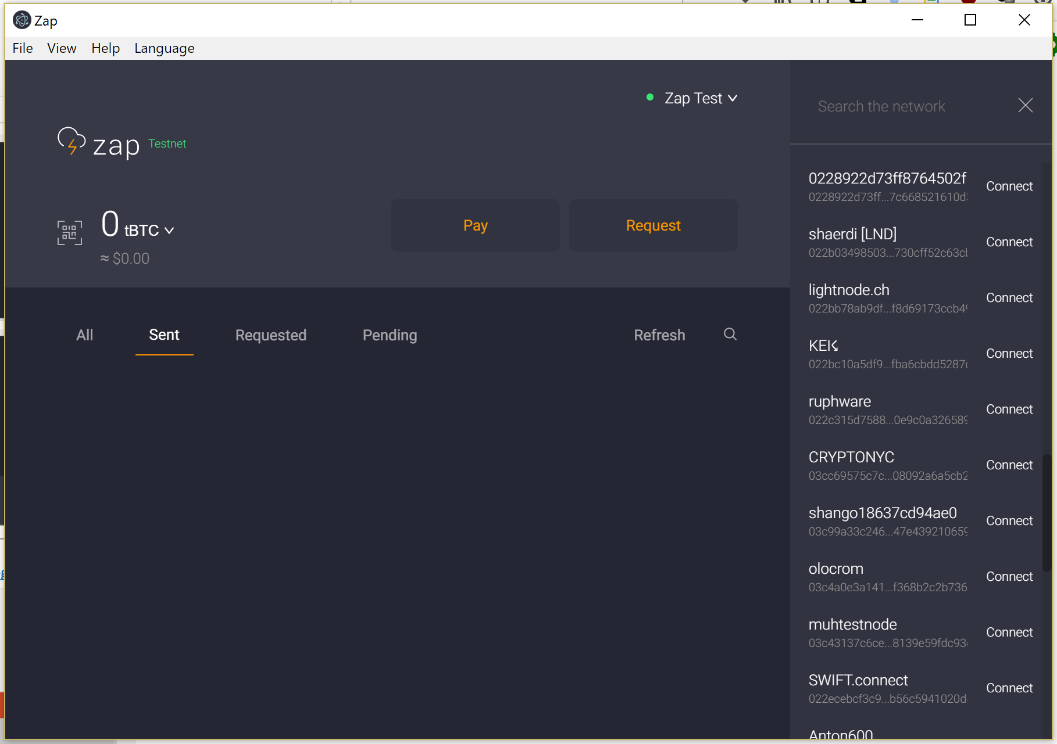
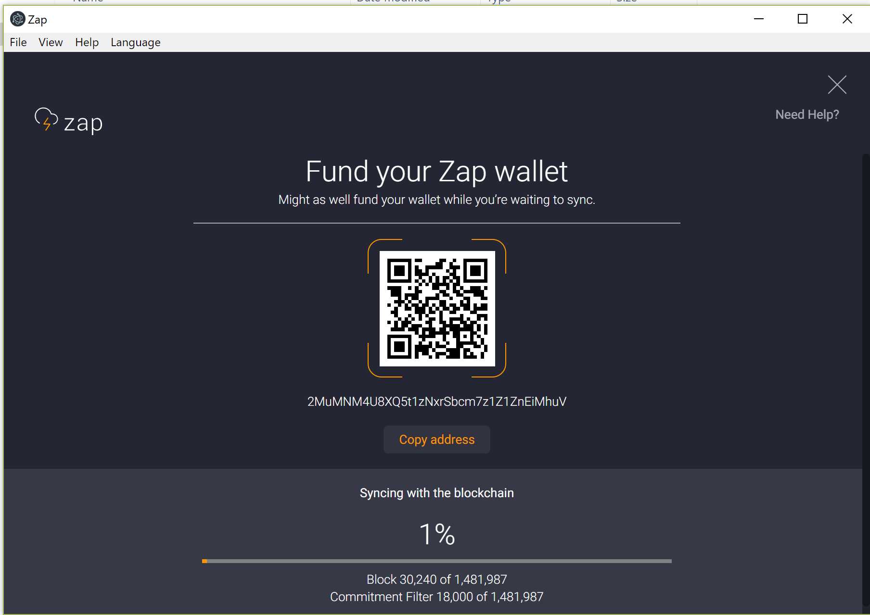
Electron Zap Client that connects to the Bitcoin Lightning Network (BLN) or the testnet version of the bitcoin network (tBTC). Runs on top of Lightning Network Daemon (LDN) and uses Autopilot.
C:\Users\downess\CodeProjects\ElectronProjects\zap-desktop
https://github.com/LN-Zap/zap-desktop
https://ln-zap.github.io/zap-tutorials/zap-desktop-getting-started

Slide 50
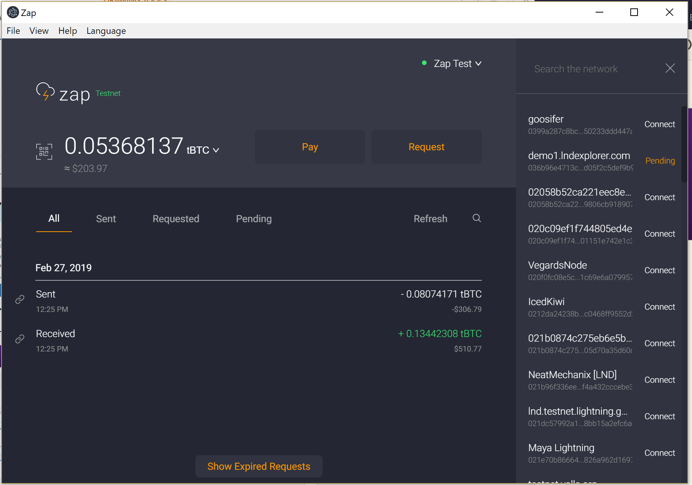
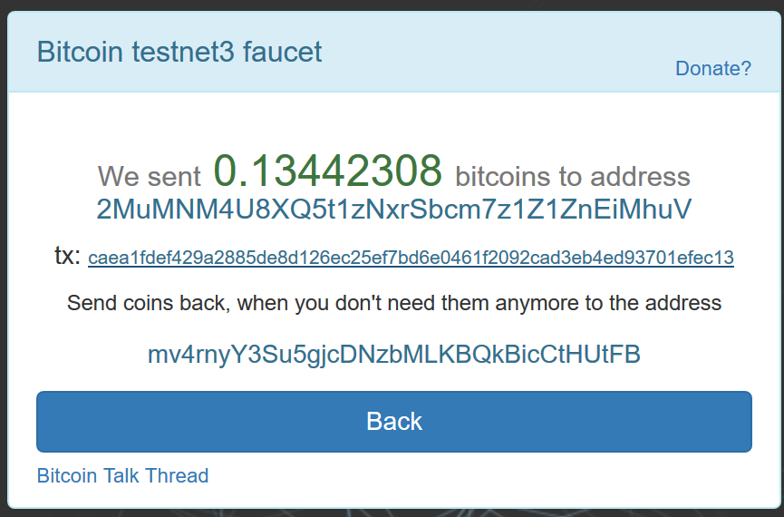
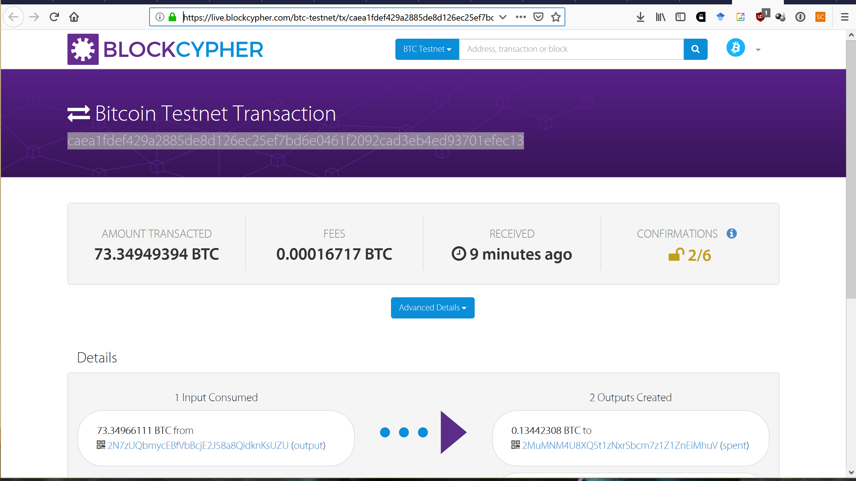
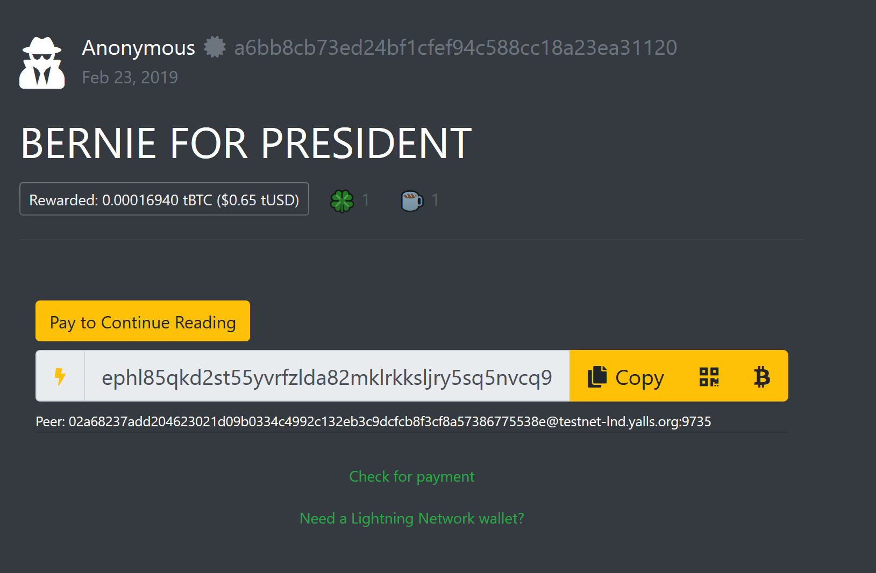
Electron Testing Zap I put tBTC into my wallet using a ‘faucet’ and then monitored the transaction. Then connect with peers on the network, create a ‘channel’ with tBTC, then ‘pay’ to (eg) read article.
C:\Users\downess\CodeProjects\ElectronProjects\zap-desktop
https://www.youtube.com/playlist?list=PLMj6UA3-f3cRfKmG1xRm3j0KBRCvbX4vW
https://testnet.yalls.org/

Slide 51
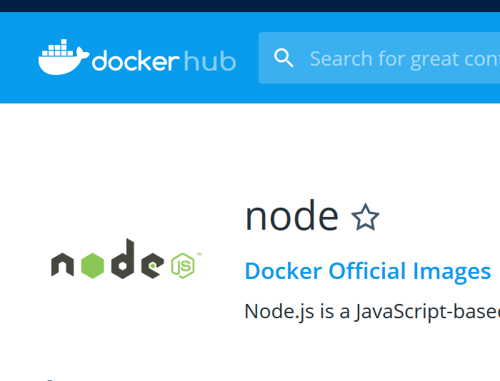
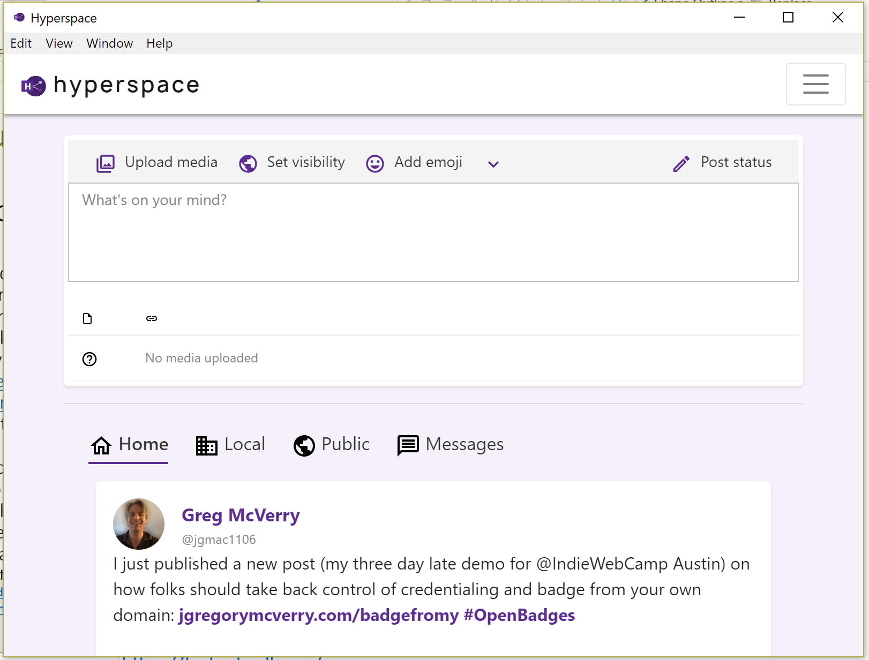
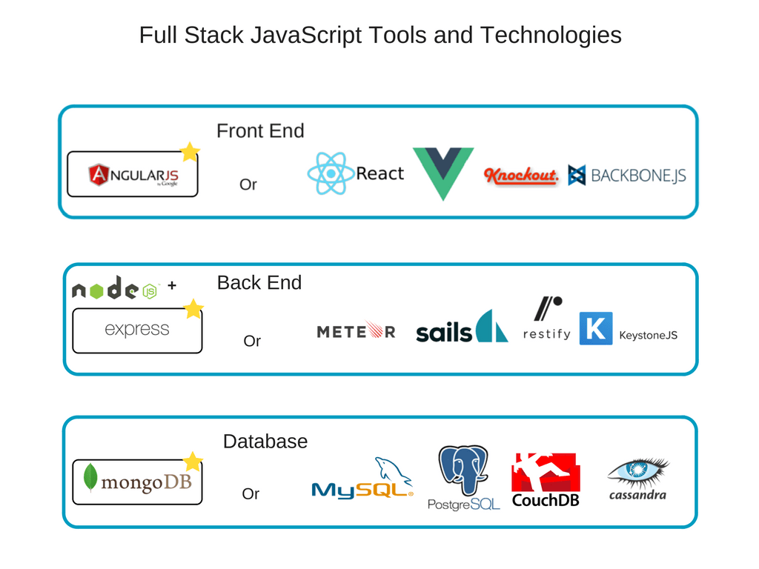
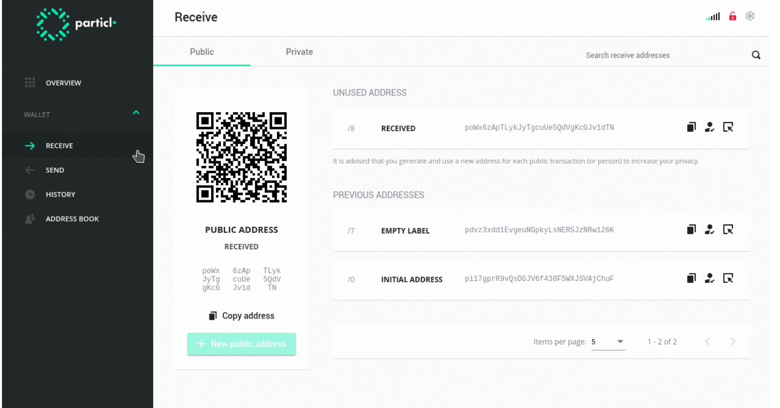
Future Directions Future directions range from social networks (Eg. Hyperspace for Mastodon), privacy (Particl), cloud (eg. Docker),
https://nodejs.org/en/docs/guides/nodejs-docker-webapp/
https://electronjs.org/apps/hyperspace
C:\Users\downess\CodeProjects\ElectronProjects\zap-desktop
https://electronjs.org/apps/particl
https://www.youtube.com/playlist?list=PLMj6UA3-f3cRfKmG1xRm3j0KBRCvbX4vW
https://testnet.yalls.org/

